Slide 1
Relational Calculus
∃
CS 186, Fall 2005
R&G, Chapter 4
∀
We will occasionally use this
arrow notation unless there
is danger of no confusion.
Ronald Graham
Elements of Ramsey Theory
Notes:
The slides for this text are organized into several modules. Each lecture contains about enough material for a 1.25 hour class period. (The time estimate is very approximate--it will vary with the instructor, and lectures also differ in length; so use this as a rough guideline.) This covers Lecture 2 (of 6) in Module (3).
Module (1): Introduction (DBMS, Relational Model)
Module (2): Storage and File Organizations (Disks, Buffering, Indexes)
Module (3): Database Concepts (Relational Queries, DDL/ICs, Views and Security)
Module (4): Relational Implementation (Query Evaluation, Optimization)
Module (5): Database Design (ER Model, Normalization, Physical Design, Tuning)
Module (6): Transaction Processing (Concurrency Control, Recovery)
Module (7): Advanced Topics

Slide 2
Relational Calculus
Comes in two flavors: Tuple relational calculus (TRC) and Domain relational calculus (DRC).
Calculus has variables, constants, comparison ops, logical connectives and quantifiers.
  TRC: Variables range over (i.e., get bound to) tuples.
    Like SQL.
  DRC: Variables range over domain elements (= field values).
    Like Query-By-Example (QBE)
  Both TRC and DRC are simple subsets of first-order logic.
    We’ll focus on TRC here
Expressions in the calculus are called formulas.
Answer tuple is an assignment of constants to variables that make the formula evaluate to true.

Slide 3
Tuple Relational Calculus
Query has the form: {T | p(T)}
  p(T) denotes a formula in which tuple variable T appears.
Answer is the set of all tuples T for which the formula p(T) evaluates to true.
Formula is recursively defined:
  start with simple atomic formulas (get tuples from relations or make comparisons of values)
  build bigger and better formulas using the logical connectives.

Slide 4
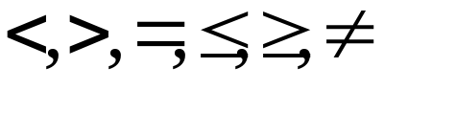
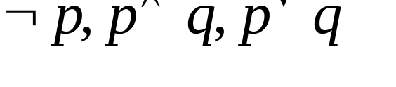


TRC Formulas
An Atomic formula is one of the following:
  R ∈ Rel
  R.a op S.b
  R.a op constant
    op is one of
A formula can be:
  an atomic formula
  where p and q are formulas
  where variable R is a tuple variable
  where variable R is a tuple variable

Slide 5

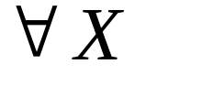
Free and Bound Variables
The use of quantifiers and in a formula is said to bind X in the formula.
  A variable that is not bound is free.
Let us revisit the definition of a query:
  {T | p(T)}
There is an important restriction
  the variable T that appears to the left of `|’ must be the only free variable in the formula p(T).
  in other words, all other tuple variables must be bound using a quantifier.

Slide 6
Selection and Projection
Find all sailors with rating above 7
  Modify this query to answer: Find sailors who are older than 18 or have a rating under 9, and are called ‘Bob’.
Find names and ages of sailors with rating above 7.
  Note: S is a tuple variable of 2 fields (i.e. {S} is a projection of Sailors)
    only 2 fields are ever mentioned and S is never used to range over any relations in the query.
{S |S ∈Sailors ∧ S.rating > 7}
{S | ∃S1 ∈Sailors(S1.rating > 7
∧ S.sname = S1.sname
∧ S.age = S1.age)}

Slide 7
Joins
Find sailors rated > 7 who’ve reserved boat #103
  Note the use of ∃ to find a tuple in Reserves that `joins with’ the Sailors tuple under consideration.
{S | S∈Sailors ∧ S.rating > 7 ∧
∃R(R∈Reserves ∧ R.sid = S.sid
∧ R.bid = 103)}

Slide 8
Joins (continued)
{S | S∈Sailors ∧ S.rating > 7 ∧
∃R(R∈Reserves ∧ R.sid = S.sid
∧ ∃B(B∈Boats ∧ B.bid = R.bid
∧ B.color = ‘red’))}
{S | S∈Sailors ∧ S.rating > 7 ∧
∃R(R∈Reserves ∧ R.sid = S.sid
∧ R.bid = 103)}
Find sailors rated > 7 who’ve reserved a red boat
Find sailors rated > 7 who’ve reserved boat #103
Observe how the parentheses control the scope of each quantifier’s binding.
This may look cumbersome, but it’s not so different from SQL!

Slide 9
Division (makes more sense here???)
Find sailors who’ve reserved all boats
(hint, use ∀)
{S | S∈Sailors ∧
∀B∈Boats (∃R∈Reserves
(S.sid = R.sid
∧ B.bid = R.bid))}
Find all sailors S such that for all tuples B in Boats there is a tuple in Reserves showing that sailor S has reserved B.

Slide 10
Division – a trickier example…
Find sailors who’ve reserved all Red boats
{S | S∈Sailors ∧
∀B ∈ Boats ( B.color = ‘red’ ⇒
∃R(R∈Reserves ∧ S.sid = R.sid
∧ B.bid = R.bid))}
Alternatively…
{S | S∈Sailors ∧
∀B ∈ Boats ( B.color ≠ ‘red’ ∨
∃R(R∈Reserves ∧ S.sid = R.sid
∧ B.bid = R.bid))}

Slide 11
a ⇒ b is the same as ¬a ∨ b
b
If a is true, b must be true!
  If a is true and b is false, the implication evaluates to false.
If a is not true, we don’t care about b
  The expression is always true.
T F
T
T
F
a
F
T
T

Slide 12
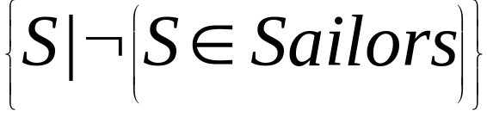
Unsafe Queries, Expressive Power
∃ syntactically correct calculus queries that have an infinite number of answers! Unsafe queries.
  e.g.,
  Solution???? Don’t do that!
Expressive Power (Theorem due to Codd):
  every query that can be expressed in relational algebra can be expressed as a safe query in DRC / TRC; the converse is also true.
Relational Completeness: Query language (e.g., SQL) can express every query that is expressible in relational algebra/calculus. (actually, SQL is more powerful, as we will see…)

Slide 13
Summary
The relational model has rigorously defined query languages — simple and powerful.
Relational algebra is more operational
  useful as internal representation for query evaluation plans.
Relational calculus is non-operational
  users define queries in terms of what they want, not in terms of how to compute it. (Declarative)
Several ways of expressing a given query
  a query optimizer should choose the most efficient version.
Algebra and safe calculus have same expressive power
  leads to the notion of relational completeness.

Slide 14
Addendum: Use of ∀
∀x (P(x)) - is only true if P(x) is true for every x in the universe
Usually:
  ∀x ((x ∈ Boats) ⇒ (x.color = “Red”)
⇒ logical implication,
  a ⇒ b means that if a is true, b must be true
  a ⇒ b is the same as ¬a ∨ b

Slide 15
Find sailors who’ve reserved all boats
{S | S∈Sailors ∧
∀B( (B∈Boats) ⇒
∃R(R∈Reserves ∧ S.sid = R.sid
∧ B.bid = R.bid))}
Find all sailors S such that for each tuple B either it is not a tuple in Boats or there is a tuple in Reserves showing that sailor S has reserved it.
{S | S∈Sailors ∧
∀B(¬(B∈Boats) ∨
∃R(R∈Reserves ∧ S.sid = R.sid
∧ B.bid = R.bid))}

Slide 16
... reserved all red boats
{S | S∈Sailors ∧
∀B( (B∈Boats ∧ B.color = “red”) ⇒
∃R(R∈Reserves ∧ S.sid = R.sid
∧ B.bid = R.bid))}
Find all sailors S such that for each tuple B either it is not a tuple in Boats or there is a tuple in Reserves showing that sailor S has reserved it.
{S | S∈Sailors ∧
∀B(¬(B∈Boats) ∨ (B.color ≠ “red”) ∨
∃R(R∈Reserves ∧ S.sid = R.sid
∧ B.bid = R.bid))}

Slide 17
SQL: The Query Language
Part 1
CS186, Fall 2005
R&G, Chapter 5
Life is just a bowl of queries.
-Anon
(not Forrest Gump)
Notes:
The slides for this text are organized into several modules. Each lecture contains about enough material for a 1.25 hour class period. (The time estimate is very approximate--it will vary with the instructor, and lectures also differ in length; so use this as a rough guideline.) This covers Lectures 3 and 4 (of 6) in Module (3).
Module (1): Introduction (DBMS, Relational Model)
Module (2): Storage and File Organizations (Disks, Buffering, Indexes)
Module (3): Database Concepts (Relational Queries, DDL/ICs, Views and Security)
Module (4): Relational Implementation (Query Evaluation, Optimization)
Module (5): Database Design (ER Model, Normalization, Physical Design, Tuning)
Module (6): Transaction Processing (Concurrency Control, Recovery)
Module (7): Advanced Topics

Slide 18
Relational Query Languages
A major strength of the relational model: supports simple, powerful querying of data.
Two sublanguages:
DDL – Data Definition Language
  define and modify schema (at all 3 levels)
DML – Data Manipulation Language
  Queries can be written intuitively.
The DBMS is responsible for efficient evaluation.
  The key: precise semantics for relational queries.
  Allows the optimizer to re-order/change operations, and ensure that the answer does not change.
  Internal cost model drives use of indexes and choice of access paths and physical operators.

Slide 19
The SQL Query Language
The most widely used relational query language.
  Current standard is SQL-1999
    Not fully supported yet
    Introduced “Object-Relational” concepts (and lots more)
      Many of which were pioneered in Postgres here at Berkeley!
  SQL-200x is in draft
  SQL-92 is a basic subset
    Most systems support a medium
  PostgreSQL has some “unique” aspects
    as do most systems.
  XML support/integration is the next challenge for SQL (more on this in a later class).

Slide 20
DDL – Create Table
CREATE TABLE table_name ( { column_name data_type [ DEFAULT default_expr ] [ column_constraint [, ... ] ] | table_constraint } [, ... ] )
Data Types (PostgreSQL) include:
  character(n) – fixed-length character string
  character varying(n) – variable-length character string
  smallint, integer, bigint, numeric, real, double precision
  date, time, timestamp, …
  serial - unique ID for indexing and cross reference
  …
PostgreSQL also allows OIDs, arrays, inheritance, rules…
  conformance to the SQL-1999 standard is variable so we won’t use these in the project.

Slide 21
Create Table (w/column constraints)
CREATE TABLE table_name ( { column_name data_type [ DEFAULT default_expr ] [ column_constraint [, ... ] ] | table_constraint } [, ... ] )
Column Constraints:
[ CONSTRAINT constraint_name ] { NOT NULL | NULL | UNIQUE | PRIMARY KEY | CHECK (expression) |
REFERENCES reftable [ ( refcolumn ) ] [ ON DELETE action ] [ ON UPDATE action ] }
action is one of:
NO ACTION, CASCADE, SET NULL, SET DEFAULT
expression for column constraint must produce a boolean result and reference the related column’s value only.

Slide 22
Create Table (w/table constraints)
CREATE TABLE table_name ( { column_name data_type [ DEFAULT default_expr ] [ column_constraint [, ... ] ] | table_constraint } [, ... ] )
Table Constraints:
[ CONSTRAINT constraint_name ]
{ UNIQUE ( column_name [, ... ] ) |
PRIMARY KEY ( column_name [, ... ] ) |
CHECK ( expression ) |
FOREIGN KEY ( column_name [, ... ] ) REFERENCES reftable [ ( refcolumn [, ... ] ) ] [ ON DELETE action ] [ ON UPDATE action ] }
Here, expressions, keys, etc can include multiple columns

Slide 23
Create Table (Examples)
CREATE TABLE films (
code CHAR(5) PRIMARY KEY,
title VARCHAR(40),
did DECIMAL(3),
date_prod DATE,
kind VARCHAR(10),
CONSTRAINT production UNIQUE(date_prod)
FOREIGN KEY did REFERENCES distributors ON DELETE NO ACTION
);
CREATE TABLE distributors (
did DECIMAL(3) PRIMARY KEY,
name VARCHAR(40)
CONSTRAINT con1 CHECK (did > 100 AND name <> ‘ ’)
);

Slide 24
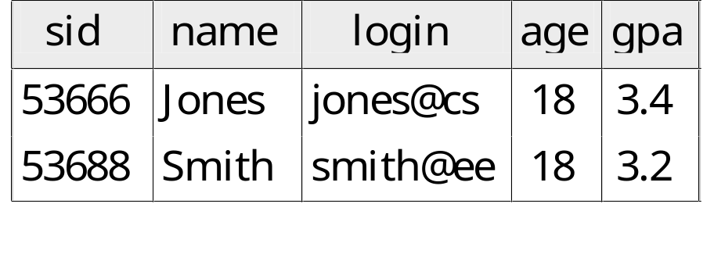
The SQL DML
Single-table queries are straightforward.
To find all 18 year old students, we can write:
SELECT *
FROM Students S
WHERE S.age=18
To find just names and logins, replace the first line:
SELECT S.name, S.login

Slide 25
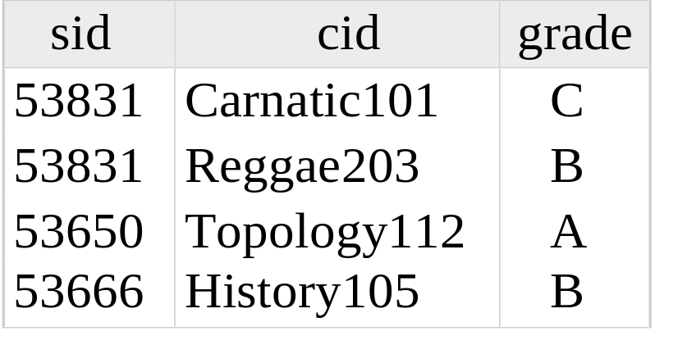
Querying Multiple Relations
Can specify a join over two tables as follows:
SELECT S.name, E.cid
FROM Students S, Enrolled E
WHERE S.sid=E.sid AND E.grade=‘B'
Note: obviously no referential integrity constraints have been used here.
S.name E.cid
Jones History105
result =

Slide 26

Basic SQL Query
SELECT [DISTINCT] target-list
FROM relation-list
WHERE qualification
relation-list : A list of relation names
  possibly with a range-variable after each name
target-list : A list of attributes of tables in relation-list
qualification : Comparisons combined using AND, OR and NOT.
  Comparisons are Attr op const or Attr1 op Attr2, where op is one of
DISTINCT: optional keyword indicating that the answer should not contain duplicates.
  In SQL SELECT, the default is that duplicates are not eliminated! (Result is called a “multiset”)

Slide 27
Query Semantics
Semantics of an SQL query are defined in terms of the following conceptual evaluation strategy:
  1. do FROM clause: compute cross-product of tables (e.g., Students and Enrolled).
  2. do WHERE clause: Check conditions, discard tuples that fail. (called “selection”).
  3. do SELECT clause: Delete unwanted fields. (called “projection”).
  4. If DISTINCT specified, eliminate duplicate rows.
Probably the least efficient way to compute a query!
  An optimizer will find more efficient strategies to get the same answer.

Slide 28
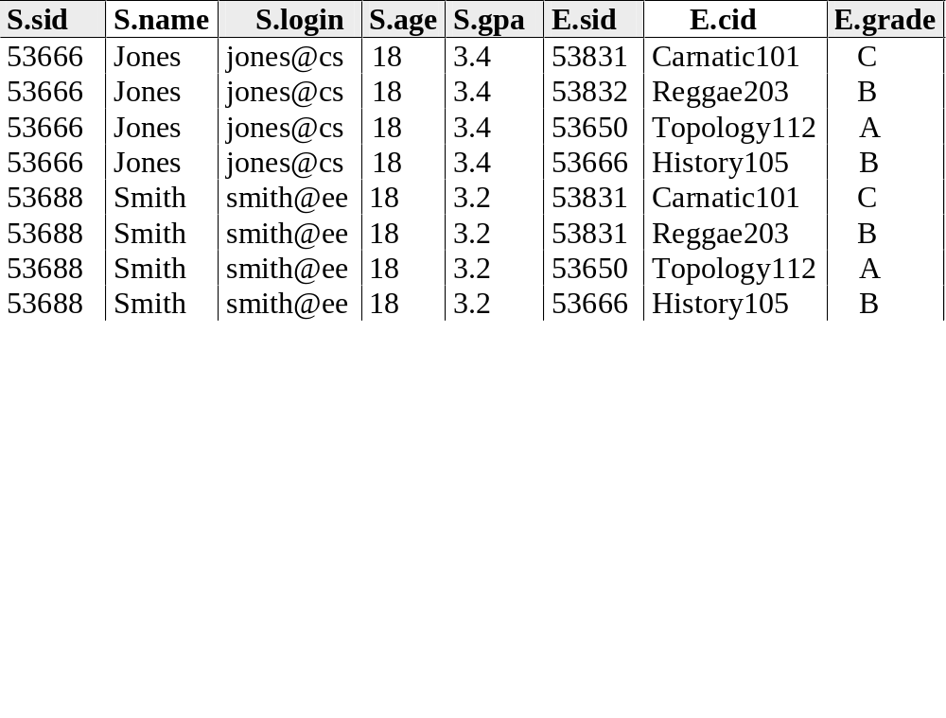
Step 1 – Cross Product
SELECT S.name, E.cid
FROM Students S, Enrolled E
WHERE S.sid=E.sid AND E.grade=‘B'

Slide 29
Step 2) Discard tuples that fail predicate
SELECT S.name, E.cid
FROM Students S, Enrolled E
WHERE S.sid=E.sid AND E.grade=‘B'

Slide 30
Step 3) Discard Unwanted Columns
SELECT S.name, E.cid
FROM Students S, Enrolled E
WHERE S.sid=E.sid AND E.grade=‘B'

Slide 31
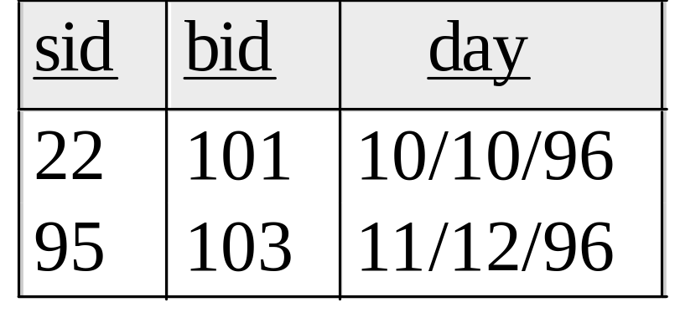
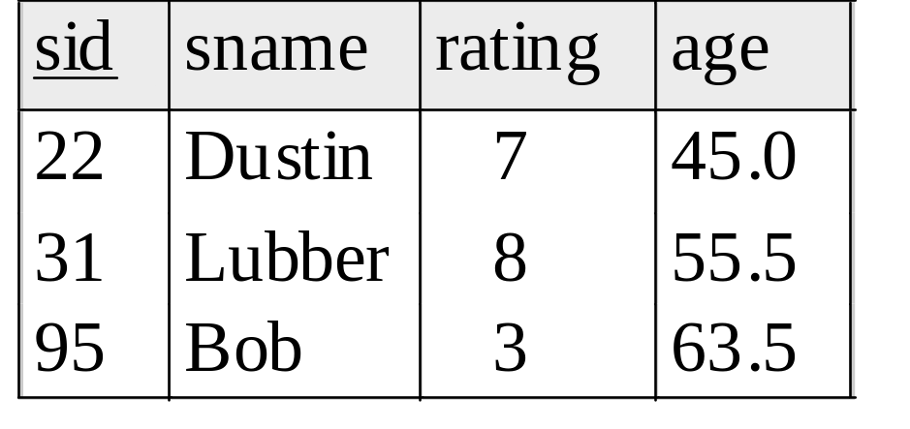
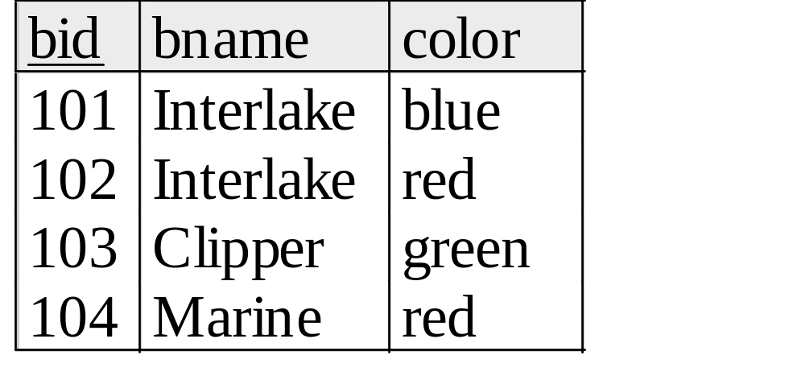
Now the Details
Reserves
We will use these instances of relations in our examples.
(Question: If the key for the Reserves relation contained only the attributes sid and bid, how would the semantics differ?)
Sailors
Boats

Slide 32
Example Schemas
CREATE TABLE Sailors (sid INTEGER PRIMARY KEY,
sname CHAR(20),rating INTEGER,age REAL)
CREATE TABLE Boats (bid INTEGER PRIMARY KEY,
bname CHAR (20), color CHAR(10))
CREATE TABLE Reserves (
sid INTEGER REFERENCES Sailors,
bid INTEGER, day DATE,
PRIMARY KEY (sid, bid, day),
FOREIGN KEY (bid) REFERENCES Boats)

Slide 33
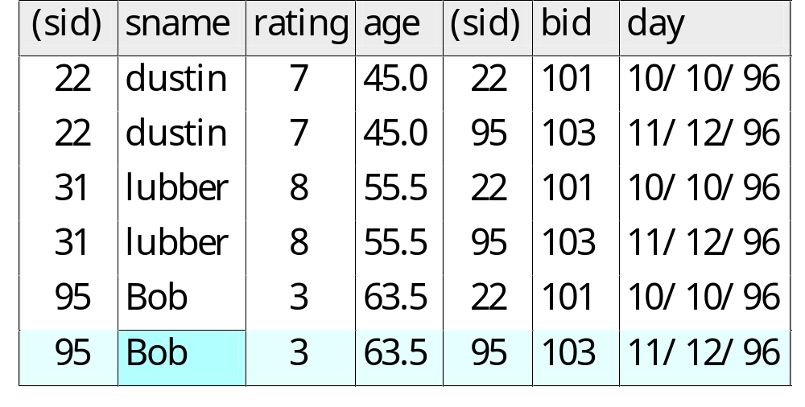
Another Join Query
SELECT sname
FROM Sailors, Reserves
WHERE Sailors.sid=Reserves.sid
AND bid=103

Slide 34
Some Notes on Range Variables
Can associate “range variables” with the tables in the FROM clause.
  saves writing, makes queries easier to understand
Needed when ambiguity could arise.
  for example, if same table used multiple times in same FROM (called a “self-join”)
SELECT sname
FROM Sailors,Reserves
WHERE Sailors.sid=Reserves.sid AND bid=103
Can be
rewritten using
range variables as:
SELECT S.sname
FROM Sailors S, Reserves R
WHERE S.sid=R.sid AND bid=103

Slide 35
More Notes
Here’s an example where range variables are required (self-join example):
Note that target list can be replaced by “*” if you don’t want to do a projection:
SELECT x.sname, x.age, y.sname, y.age
FROM Sailors x, Sailors y
WHERE x.age > y.age
SELECT *
FROM Sailors x
WHERE x.age > 20

Slide 36
Find sailors who’ve reserved at least one boat
SELECT S.sid
FROM Sailors S, Reserves R
WHERE S.sid=R.sid
Would adding DISTINCT to this query make a difference?
What is the effect of replacing S.sid by S.sname in the SELECT clause?
  Would adding DISTINCT to this variant of the query make a difference?

Slide 37
Expressions
Can use arithmetic expressions in SELECT clause (plus other operations we’ll discuss later)
Use AS to provide column names
Can also have expressions in WHERE clause:
SELECT S.age, S.age-5 AS age1, 2*S.age AS age2
FROM Sailors S
WHERE S.sname = ‘Dustin’
SELECT S1.sname AS name1, S2.sname AS name2
FROM Sailors S1, Sailors S2
WHERE 2*S1.rating = S2.rating - 1

Slide 38
String operations
SQL also supports some string operations
“LIKE” is used for string matching.
  `_’ stands for any one character and `%’ stands for 0 or more arbitrary characters.
SELECT S.age, S.age-5 AS age1, 2*S.age AS age2
FROM Sailors S
WHERE S.sname LIKE ‘B_%b’

Slide 39
Find sid’s of sailors who’ve reserved a red or a green boat
UNION: Can be used to compute the union of any two union-compatible sets of tuples (which are themselves the result of SQL queries).
SELECT R.sid
FROM Boats B,Reserves R
WHERE R.bid=B.bid AND
(B.color=‘red’OR B.color=‘green’)
Vs.
SELECT R.sid
FROM Boats B, Reserves R
WHERE R.bid=B.bid AND B.color=‘red’
UNION
SELECT R.sid
FROM Boats B, Reserves R
WHERE R.bid=B.bid AND B.color=‘green’

Slide 40
Find sid’s of sailors who’ve reserved a red and a green boat
If we simply replace OR by AND in the previous query, we get the wrong answer. (Why?)
Instead, could use a self-join:
SELECT R1.sid
FROM Boats B1, Reserves R1,
Boats B2, Reserves R2
WHERE R1.sid=R2.sid
AND R1.bid=B1.bid
AND R2.bid=B2.bid
AND (B1.color=‘red’ AND B2.color=‘green’)
SELECT R.sid
FROM Boats B,Reserves R
WHERE R.bid=B.bid AND
(B.color=‘red’ AND B.color=‘green’)

Slide 41
AND Continued…
Key field!
INTERSECT:discussed in book. Can be used to compute the intersection of any two union-compatible sets of tuples.
Also in text: EXCEPT (sometimes called MINUS)
Included in the SQL/92 standard, but many systems don’t support them.
  But PostgreSQL does!
SELECT S.sid
FROM Sailors S, Boats B, Reserves R
WHERE S.sid=R.sid
AND R.bid=B.bid
AND B.color=‘red’
INTERSECT
SELECT S.sid
FROM Sailors S, Boats B, Reserves R
WHERE S.sid=R.sid
AND R.bid=B.bid
AND B.color=‘green’

Slide 42
Nested Queries
Powerful feature of SQL: WHERE clause can itself contain an SQL query!
  Actually, so can FROM and HAVING clauses.
To find sailors who’ve not reserved #103, use NOT IN.
To understand semantics of nested queries:
  think of a nested loops evaluation: For each Sailors tuple, check the qualification by computing the subquery.
Names of sailors who’ve reserved boat #103:
SELECT S.sname
FROM Sailors S
WHERE S.sid IN (SELECT R.sid
FROM Reserves R
WHERE R.bid=103)

Slide 43
Nested Queries with Correlation
Find names of sailors who’ve reserved boat #103:
SELECT S.sname
FROM Sailors S
WHERE EXISTS (SELECT *
FROM Reserves R
WHERE R.bid=103 AND S.sid=R.sid)
EXISTS is another set comparison operator, like IN.
Can also specify NOT EXISTS
If UNIQUE is used, and * is replaced by R.bid, finds sailors with at most one reservation for boat #103.
  UNIQUE checks for duplicate tuples in a subquery;
Subquery must be recomputed for each Sailors tuple.
  Think of subquery as a function call that runs a query!

Slide 44
More on Set-Comparison Operators
We’ve already seen IN, EXISTS and UNIQUE. Can also use NOT IN, NOT EXISTS and NOT UNIQUE.
Also available: op ANY, op ALL
Find sailors whose rating is greater than that of some sailor called Horatio:
SELECT *
FROM Sailors S
WHERE S.rating > ANY (SELECT S2.rating
FROM Sailors S2
WHERE S2.sname=‘Horatio’)

Slide 45
Rewriting INTERSECT Queries Using IN
Find sid’s of sailors who’ve reserved both a red and a green boat:
SELECT R.sid
FROM Boats B, Reserves R
WHERE R.bid=B.bid
AND B.color=‘red’
AND R.sid IN (SELECT R2.sid
FROM Boats B2, Reserves R2
WHERE R2.bid=B2.bid
AND B2.color=‘green’)
Similarly, EXCEPT queries re-written using NOT IN.
How would you change this to find names (not sid’s) of Sailors who’ve reserved both red and green boats?

Slide 46
Division in SQL
Find sailors who’ve reserved all boats.
SELECT S.sname
FROM Sailors S
WHERE NOT EXISTS (SELECT B.bid
FROM Boats B
WHERE NOT EXISTS (SELECT R.bid
FROM Reserves R
WHERE R.bid=B.bid
AND R.sid=S.sid))
Sailors S such that ...
there is no boat B without ...
a Reserves tuple showing S reserved B

Slide 47
Basic SQL Queries - Summary
An advantage of the relational model is its well-defined query semantics.
SQL provides functionality close to that of the basic relational model.
  some differences in duplicate handling, null values, set operators, etc.
Typically, many ways to write a query
  the system is responsible for figuring a fast way to actually execute a query regardless of how it is written.
Lots more functionality beyond these basic features. Will be covered in subsequent lectures.

Slide 48
Aggregate Operators
COUNT (*)
COUNT ( [DISTINCT] A)
SUM ( [DISTINCT] A)
AVG ( [DISTINCT] A)
MAX (A)
MIN (A)
Significant extension of relational algebra.
single column
SELECT COUNT (*)
FROM Sailors S
SELECT AVG (S.age)
FROM Sailors S
WHERE S.rating=10
SELECT COUNT (DISTINCT S.rating)
FROM Sailors S
WHERE S.sname=‘Bob’

Slide 49
Aggregate Operators
COUNT (*)
COUNT ( [DISTINCT] A)
SUM ( [DISTINCT] A)
AVG ( [DISTINCT] A)
MAX (A)
MIN (A)
single column
SELECT S.sname
FROM Sailors S
WHERE S.rating= (SELECT MAX(S2.rating)
FROM Sailors S2)
SELECT AVG ( DISTINCT S.age)
FROM Sailors S
WHERE S.rating=10

Slide 50
Find name and age of the oldest sailor(s)
SELECT S.sname, MAX (S.age)
FROM Sailors S
The first query is incorrect!
Third query equivalent to second query
  allowed in SQL/92 standard, but not supported in some systems.
    PostgreSQL seems to run it
SELECT S.sname, S.age
FROM Sailors S
WHERE S.age =
(SELECT MAX (S2.age)
FROM Sailors S2)
SELECT S.sname, S.age
FROM Sailors S
WHERE (SELECT MAX (S2.age)
FROM Sailors S2)
= S.age

Slide 51
GROUP BY and HAVING
So far, we’ve applied aggregate operators to all (qualifying) tuples.
  Sometimes, we want to apply them to each of several groups of tuples.
Consider: Find the age of the youngest sailor for each rating level.
  In general, we don’t know how many rating levels exist, and what the rating values for these levels are!
  Suppose we know that rating values go from 1 to 10; we can write 10 queries that look like this (!):
SELECT MIN (S.age)
FROM Sailors S
WHERE S.rating = i
For i = 1, 2, ... , 10:

